Slide 1
FANG: Leveraging Social Context for Fake News Detection
Using Graph Representation
Van-Hoang Nguyen
National University of Singapore
Singapore
Kazunari Sugiyama
Kyoto University
Kyoto, Japan
Preslav Nakov
Qatar Computing Research Institute, HBKU
Doha, Qatar
Min-Yen Kan
National University of Singapore
Singapore
CIKM ’20, October 19–23, 2020, Virtual Event, Ireland
陈卓敏

Slide 2
01 Introduction
Previous work proposed partial representations of social context with (i) news, sources and users as major entities, and (ii) stances, friendship, and publication as major interactions .

Slide 3
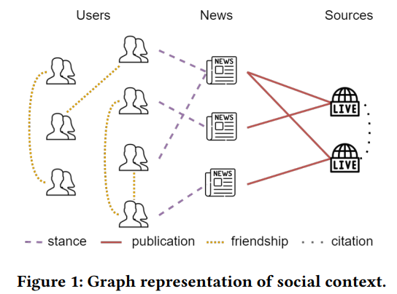
01 Introduction
Propose the Factual News Graph (FANG)
Captures social structure and engagement patterns
Improve representation quality

Slide 4
02 Methodology
the list of questionable news articles
modeled as a feature vector
the list of news sources
modeled as a feature vector
the list of social users
modeled as a feature vector
02
the list of interactions
01
modeled as a relation between two entities
03
04

Slide 5
02 Methodology
02
stance labels: neutral support, negative support, deny, report.
01
03
a social context
04

Slide 6
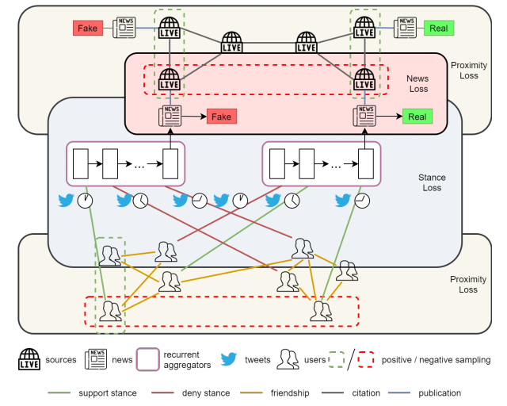
02 Methodology
02
01
03
04

Slide 7
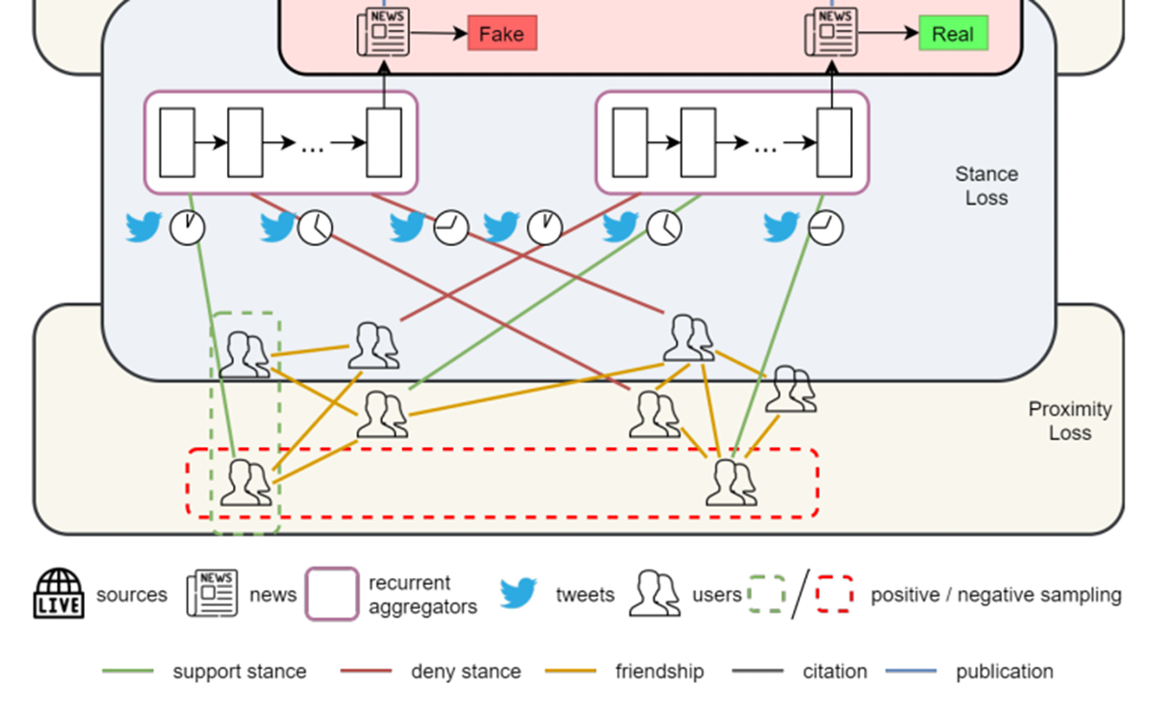
02 Methodology
News contextual representation
03
04
Bi-LSTM

Slide 8
02 Methodology
Unsupervised Proximity Loss
02
01
03
Self-supervised Stance Loss
04

Slide 9
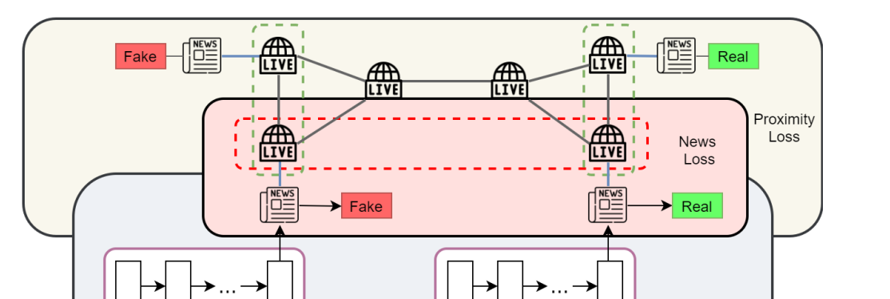
02 Methodology
News contextual representation
Supervised Fake News Loss
02
01
03
04

Slide 10
03 Experiments
Twitter 数据集
01

Slide 11
03 Experiments
01

Slide 12
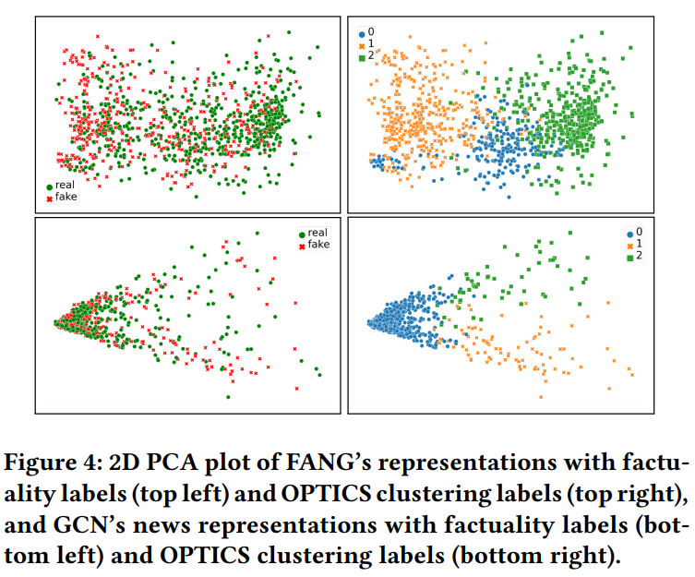
04 Discussion
01

Slide 13
04 Discussion
01

Slide 14
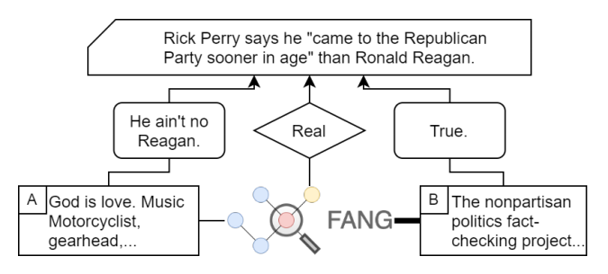
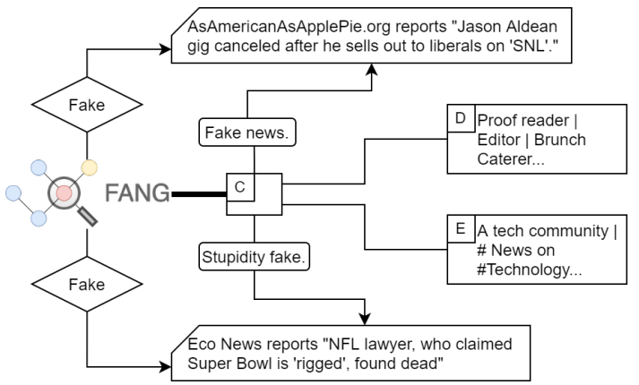
04 Discussion
01

Slide 15
T H A N K S

